Slide 1

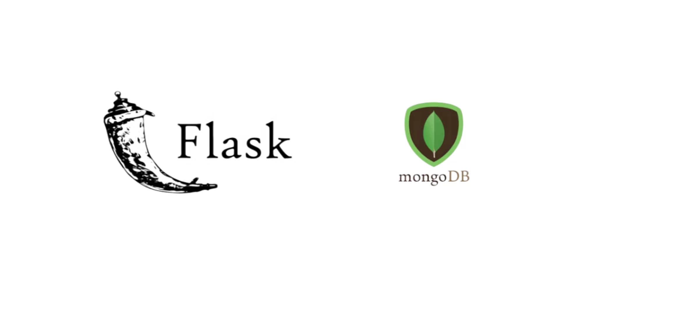
Building Dynamic Applications with Flask and MongoDB
Learn to integrate databases with Flask to create powerful, data-driven web applications
www.herovired.com

Slide 2


Flask Recap: What We Covered Last Week
What is Flask?
Why do we need databases? Static websites are limited. To build dynamic, interactive applications that remember user data, we need persistent storage.
Flask is a lightweight Python web framework that makes it simple to build web applications. It's minimal, flexible, and perfect for beginners.
Key Concepts We Mastered
Routes - URL endpoints that trigger functions
Templates - HTML files with dynamic content
Request Handling - Processing user input and forms

Slide 3
Understanding Databases for Web Applications
What is a Database?
SQL vs NoSQL
Why Use Databases?
A structured collection of data that can be easily accessed, managed, and updated. Think of it as a digital filing cabinet for your application's information.
Relational (SQL): Structured tables with relationshipsNon-Relational (NoSQL): Flexible, document-based storage
Enable user registration, store blog posts, track orders, save preferences - basically any data that needs to persist between visits.

Slide 4

Meet MongoDB: Your NoSQL Database
Document-Oriented Design
Flexible Schema
MongoDB is used by companies like Facebook, Google, and Adobe for handling massive amounts of data efficiently.
Unlike rigid SQL tables, MongoDB documents can have different structures. Perfect for rapid development and evolving requirements.
MongoDB stores data in JSON-like documents (BSON format), making it intuitive for developers familiar with JavaScript and Python dictionaries.
Modern Web Ready
Built for scalability and widely adopted by startups and enterprises. Integrates seamlessly with Flask applications.

Slide 5




MongoDB Structure: Database → Collection → Document
Document Level
Collection Level
Individual records containing your actual data in JSON format
Database Level
Groups of related documents (like "users", "products", or "posts")
Top-level container (like "student_portal" or "ecommerce_site")
Example Document Structure
{
"_id": "507f1f77bcf86cd799439011",
"name": "Sarah Johnson",
"email": "sarah@example.com",
"age": 22,
"courses": ["CS101", "MATH201"]
}
Create
Read
Update
Delete

Slide 6
Setting Up MongoDB for Development
1
2
3
Choose Your Installation
Essential Tools
Quick Start Command
Local Installation: Download from MongoDB.com for full controlMongoDB Atlas: Cloud-hosted, free tier available, no setup required
MongoDB Shell: Command-line interface for database operationsMongoDB Compass: Visual GUI for exploring and managing data
For local installation, start MongoDB with:
mongod --dbpath /data/db
Then connect using: mongo

Slide 7
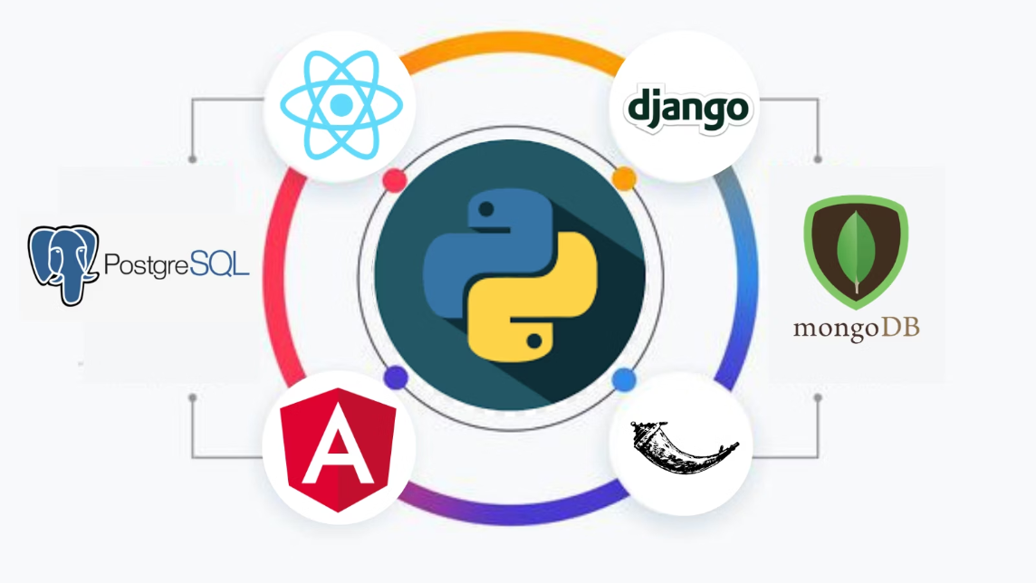

Connecting Flask to MongoDB
Required Libraries
Install the necessary Python packages to bridge Flask and MongoDB:
pip install pymongo flask-pymongo
Basic Configuration
Add this configuration to your Flask app to establish the database connection:
Pro Tip: Use MongoDB Atlas connection strings for cloud deployment instead of localhost.
from flask import Flask
from flask_pymongo
import PyMongo
app = Flask(__name__)
app.config["MONGO_URI"] = "mongodb://localhost:27017/mydb"mongo = PyMongo(app)
For production, always use environment variables to store connection strings securely!

Slide 8
CRUD Operations: Flask Meets MongoDB
Create - Insert Data
Capture form data in Flask and insert new documents into MongoDB collections. Perfect for user registrations and new content.
Read - Fetch & Display
user = {"name": name, "email": email}mongo.db.users.insert_one(user)
Query MongoDB from Flask routes and pass data to templates for dynamic rendering. Show user profiles, blog posts, product listings.
Update - Modify Records
users = mongo.db.users.find()return render_template('users.html', users=users)
Enable users to edit their profiles, update settings, or modify existing content through web forms.
mongo.db.users.update_one( {"_id": ObjectId(user_id)}, {"$set": {"email": new_email}})
Delete - Remove Data
Safely remove unwanted records while maintaining data integrity and user experience.
mongo.db.users.delete_one( {"_id": ObjectId(user_id)})

Slide 9

Mini Project: Student Registration System
Core Features
Technical Implementation
Add Students: Registration form with name, email, course selection
Flask routes for each CRUD operation
HTML forms for data input
View All: Display complete student directory
MongoDB collections for persistent storage
Update Info: Edit student details and course enrollments
Jinja2 templates for dynamic display
Remove Students: Delete records with confirmation
This project demonstrates real-world database integration patterns you'll use in larger applications.

Slide 10


Key Takeaways & Next Steps
Flask + Database = Dynamic Apps
MongoDB: Beginner-Friendly Choice
Combining Flask with MongoDB transforms static websites into interactive, data-driven applications that can grow with your needs.
Its flexible document structure and intuitive JSON-like format make MongoDB ideal for learning database concepts without SQL complexity.
Ready to build something amazing? Your dynamic web development journey starts now!

Slide 11

Thank You
www.herovired.com
Wait Nahi, Great Kar!

